Slide 1
Chapter 4
How to use CSS to format the elements of a web page

Slide 2
Objectives (part 1)
Applied
Given an HTML document, create a CSS style sheet for formatting the web page using any of the types of selectors or rules that are presented in this chapter.
Given an HTML document with one or more CSS style sheets applied to it, use the Chrome’s Developer Tools to inspect the styles.

Slide 3
Objectives (part 2)
Knowledge
Describe three ways to include CSS in a web page.
Explain why it’s usually best to use an external style sheet for formatting a page.
Describe the use of these CSS selectors: type, ID, class.
Describe the purpose of the normalize.css style sheet and explain why it’s no longer needed.
Distinguish between absolute and relative units of measurement.
Describe three basic ways to specify color in CSS, and describe how RGBA, HSL, and HSLA colors let you expand upon that.
Describe these properties for styling fonts: font-family, font-style, font-weight, font-size, and line-height.
Describe these properties for formatting text: text-indent, text-align, text-decoration, and text-shadow.

Slide 4
Objectives (part 3)
Describe the use of the float and clear properties for floating images.
Describe these types of selectors: universal, type, id, class, descendant, child, sibling, pseudo-class, and pseudo-element.
Describe one accessibility guideline for using pseudo-class selectors.
Explain how user style sheets, !important rules, and specificity are used in the cascade order for applying style rules.
Describe the use of a custom property (CSS variable).

Slide 5
Three ways to provide styles
Use an external style sheet by coding a link element in the head section
<link rel="stylesheet" href="styles/main.css">
Embed the styles in the head section
<style>
body {
font-family: Arial, Helvetica, sans-serif;
font-size: 100%; }
h1 { font-size: 250%; }
</style>
Use the style attribute to apply styles to a single element
<h1 style="font-size: 500%; color: red;">Valley Town Hall</h1>

Slide 6
The sequence in which the provided styles are applied
Styles from an external style sheet
Embedded styles
Inline styles

Slide 7
A head element that includes two style sheets
<head>
<title>San Joaquin Valley Town Hall</title>
<link rel="stylesheet" href="../styles/main.css">
<link rel="stylesheet" href="../styles/speaker.css">
</head>
The sequence in which the styles are applied
From the first external style sheet to the last

Slide 8
HTML that can be selected by element type, id, or class
<main>
<h1>This Season's Speaker Lineup</h1>
<p class="blue">October: Jeffrey Toobin</p>
<p class="blue">November: Andrew Ross Sorkin</p>
</main>
<footer>
<p id="copyright" class="blue right">Copyright 2022</p>
</footer>

Slide 9
CSS style rules by element type, id, and class
All elements
* { margin: .5em 1em; }
Elements by type
main {
border: 2px solid black;
padding: 1em; }
h1 { font-family: Arial, sans-serif; }
p { margin-left: 3em; }
One element by ID
#copyright { font-size: 80%; }
Elements by class
.blue { color: blue; }
.right { text-align: right; }

Slide 10
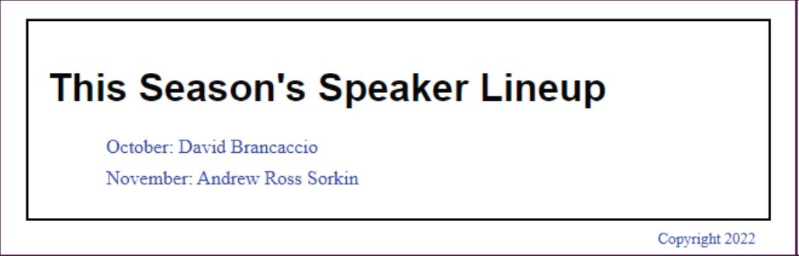
The elements displayed in a browser

Slide 11
The URL for the normalize.css style sheet
http://necolas.github.io/normalize.css/
What the normalize.css style sheet does
Normalize.css makes minor adjustments to browser defaults so all browsers render HTML elements the same way.
It also sets the default font family to sans-serif.

Slide 12
Drawbacks of using normalize.css
It requires a small amount of overhead.
It’s a third-party dependency.

Slide 13
Common units of measure
px
pt
em
rem
%

Slide 14
The HTML for a web page that will have borders
<body>
<header>
<h1>San Joaquin Valley Town Hall</h1>
</header>
<main>
<p>Welcome to San Joaquin Valley Town Hall. We have some fascinating speakers for you this season!</p>
</main>
</body>

Slide 15
CSS that uses relative units of measure with a fixed border
body {
font-size: 100%;
margin-left: 2em;
margin-right: 2em; }
header {
padding-bottom: .75em;
border-bottom: 3px solid black;
margin-bottom: 0; }
h1 {
font-size: 200%;
margin-bottom: 0; }

Slide 16
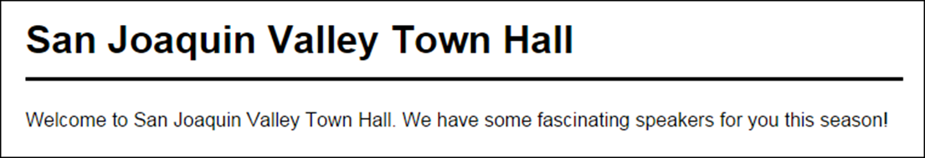
The web page with borders in a web browser

Slide 17
Three ways to specify colors
With a color name
color: silver;
With an RGB (red-green-blue) value
color: rgb(100%, 40%, 20%);
color: rgb(255, 102, 51); /* Using multiples of 51 from 0 to 255 */
With an RGB value that uses hexadecimal numbers
color: #ffffff; /* This color is white */
color: #000000; /* This color is black */
color: #ff0000; /* This color is red */

Slide 18
CSS that uses hexadecimal values for colors
body {
font-size: 100%;
margin-left: 2em;
background-color: #FFFFCC; } /* This could also be coded as #FFC */
h1 {
font-size: 200%;
color: #00F; } /* This could also be coded as #0000FF */

Slide 19
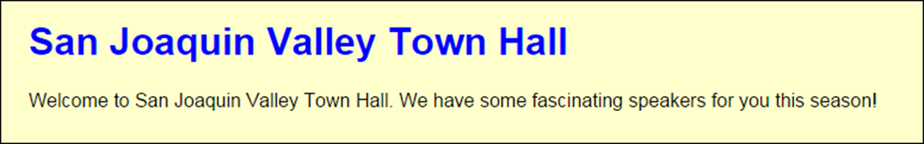
The hex colors in a web browser

Slide 20
Accessibility guideline for colors
Remember the visually-impaired.
Dark text on a light background is easier to read, and black type on a white background is easiest to read.

Slide 21
Three more ways to code colors
The syntax for RGBA colors
rgba(red%, green%, blue%, opacity-value)
The syntax for HSL and HSLA colors
hsl(hue-degrees, saturation%, lightness%)
hsla(hue-degrees, saturation%, lightness%, opacity-value)
The CSS values for colors
opacity-value
hue-degrees
saturation%
lightness%

Slide 22
Examples of RGBA, HSL, and HSLA colors
h1 { color: rgba(0, 0, 255, .2) /* transparent blue */ }
h1 { color: hsl(120, 100%, 25%) /* dark green */ }
h1 { color: hsl(120, 75%, 75%) /* pastel green */ }
h1 { color: hsla(240, 100%, 50%, 0.5) /* semi-transparent solid blue */ }

Slide 23
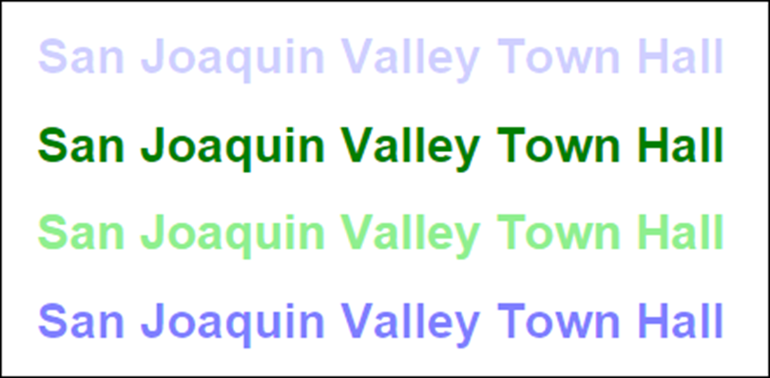
The colors in a browser

Slide 24
The five generic font families
serif
sans-serif
monospace
cursive
fantasy

Slide 25
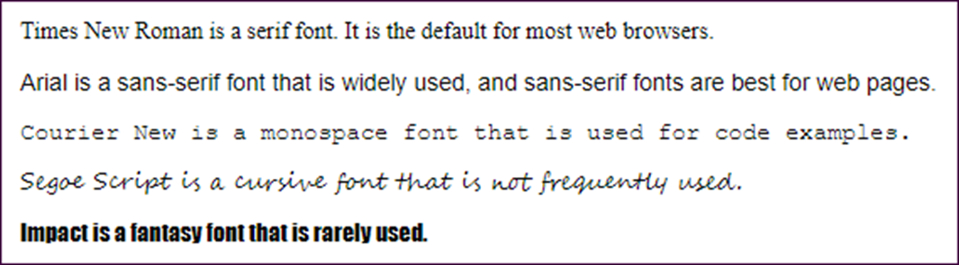
Examples of the five generic font families

Slide 26
How to specify a font family and font size
Font family
font-family: Arial, Helvetica, sans-serif;
font-family: "Times New Roman", Times, serif;
font-family: "Courier New", Courier, monospace;
Font size
font-size: 12pt; /* in points */
font-size: 150%; /* as a percent of the parent element */
font-size: 1.5em; /* same as 150% */

Slide 27
A font-family rule in the body element that is inherited by all descendants
body {
font-family: Arial, Helvetica, sans-serif;
font-size: 100%; }
A font-family rule in a descendent that overrides the inherited font family
p { font-family: "Times New Roman", Times, serif; }

Slide 28
Properties for styling fonts
font-style
font-weight
font-variant
line-height

Slide 29
How to specify the properties for styling fonts
With font styles and variants
font-style: italic;
font-style: normal; /* remove style */
font-variant: small-caps;
With font weights
font-weight: 700;
font-weight: bold; /* same as 700 */
font-weight: normal; /* same as 400 */
font-weight: lighter; /* relative to the parent element */
With line heights
line-height: 14pt;
line-height: 140%;
line-height: 1.4em; /* same as 140% */
line-height: 1.4; /* same as 140% and 1.4em */

Slide 30
The shorthand font property
font: [style] [weight] [variant] size[/line-height] family;
How to use the shorthand font property
font: italic bold 14px/19px Arial, sans-serif;
font: small-caps 150% "Times New Roman", Times, serif;
font: 90%/120% "Comic Sans MS", Impact, sans-serif;

Slide 31
Properties for indenting, aligning, and decorating text
text-indent
text-align
vertical-align
text-decoration

Slide 32
The HTML for a footer
<footer>
<p>&copy; Copyright 2022 San Joaquin Valley Town Hall.</p>
</footer>
CSS that right aligns the paragraph in the footer
footer p {
font-size: 80%;
text-align: right;
}

Slide 33
The text-shadow property
text-shadow: horizontalOffset, verticalOffset, blurRadius, shadowColor;
A heading that uses a shadow
The h1 element
<h1>San Joaquin Valley Town Hall</h1>
The CSS
h1 {
color: #ef9c00;
text-shadow: 4px 4px; }

Slide 34

The heading in a browser

Slide 35
Another way to apply a shadow
The h1 element
<h1>San Joaquin Valley Town Hall</h1>
The CSS
h1 {
color: blue;
text-shadow: -2px -2px 4px red; }

Slide 36

Another heading in a browser

Slide 37
Accessibility guideline for shadows
Remember the visually-impaired. Too much shadow or blur makes text harder to read.

Slide 38

An image that has been floated to the left of the headings that follow

Slide 39
The HTML and CSS for the floated image
The HTML
<img src="images/logo.gif" alt="Town Hall Logo" width="80">
<h1>San Joaquin Valley Town Hall</h1>
<h2>Bringing cutting-edge speakers to the valley</h2>
The CSS
img {
float: left;
margin-right: 1em;
}

Slide 40

The page if the image width is reduced to 40

Slide 41
The property that will stop the floating before a subsequent element
main { clear: left; }

Slide 42
HTML that can be selected by relationships
<main>
<h1>This Season's Town Hall speakers</h1>
<ul class="speakers">
<li>January: <a href="speakers/brancaccio.html">
David Brancaccio</a></li>
<li>February: <a href="speakers/fitzpatrick.html">
Robert Fitzpatrick</a></li>
<li>March: <a href="speakers/williams.html">
Juan Williams</a></li>
</ul>
<h2>Post-lecture luncheons</h2>
<p>Extend the excitement by going to the luncheon</p>
<p>A limited number of tickets are available.</p>
<p><em>Contact us by phone</em> at (559) 555- 1212.</p>
</main>

Slide 43
CSS style rules with relational selectors
Descendant
main li { font-size: 90%; }
ul a { color: green; }
Adjacent sibling
h2+p { margin-top: .5em; }
Child
main>p { font-size: 80%; }
li>a { color: green; }
General sibling
h2~p { margin-left: 2em; }

Slide 44
Combinations of selectors
A selector for a class within an element
ul.speakers {
list-style-type: square;
}
Multiple selectors
h1, h2, h3 {
color: blue;
}
p, ul.speakers li {
font-family: "Times New Roman", serif;
}

Slide 45
Attribute selectors
All elements with href attributes
*[href] {
font-size: 95%;
}
All <a> elements with href attributes
a[href] {
font-family: Arial, sans-serif;
}
All input elements with type attributes that have a value of “submit”
input[type="submit"] {
border: 1px solid black;
color: #ef9c00;
background-color: #facd8a;
}

Slide 46
Common CSS pseudo-classes
:link
:visited
:active
:hover
:focus
:first-child
:last-child
:only-child
Common CSS pseudo-elements
::first-letter
::first-line

Slide 47
HTML that can be used by pseudo-class and pseudo-element selectors
<main>
<p>Welcome to San Joaquin Valley Town Hall.</p>
<p>We have some fascinating speakers for you this season!</p>
<ul>
<li><a href="Brancaccio.html">David Brancaccio</a></li>
<li><a href="sorkin.html">Andrew Ross Sorkin</a></li>
<li><a href="chua.html">Amy Chua</a></li></ul>
</main>

Slide 48
The CSS for pseudo-class and pseudo-element selectors
a:link {
color: green;
}
a:hover, a:focus {
color: fuchsia
}
main p:first-child {
font-weight: bold;
}
main p:first-child::first-letter {
font-size: 150%
}

Slide 49
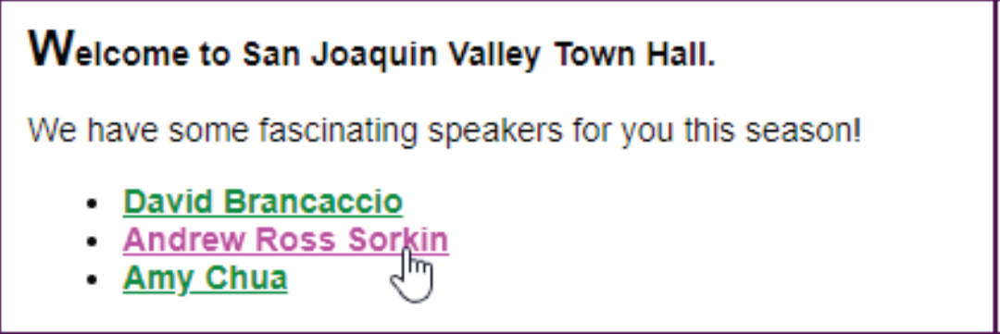
The pseudo-class and pseudo-element selectors in a browser

Slide 50
Accessibility guideline for :hover and :focus
Apply the same formatting to the :hover and :focus pseudo-classes for an element.
That way, those who can’t use the mouse will have the same experience as those who can.

Slide 51
If more than one style rule at a cascade level is applied to an element…
Use the style rule with the highest specificity.
If the specificity is the same for two or more style rules in a group, use the style rule that’s specified last.
How to determine the specificity of a selector
An id is the most specific.
A class, attribute selector, or pseudo-class selector is less specific.
An element or pseudo-element selector is least specific.

Slide 52
The cascade order for applying CSS style rules
!important rules in a user style sheet
!important rules in a web page
Normal rules in a web page
Normal rules in a user style sheet
Default rules in the web browser

Slide 53
How to identify a rule as important
.highlight {
font-weight: bold !important;
}

Slide 54
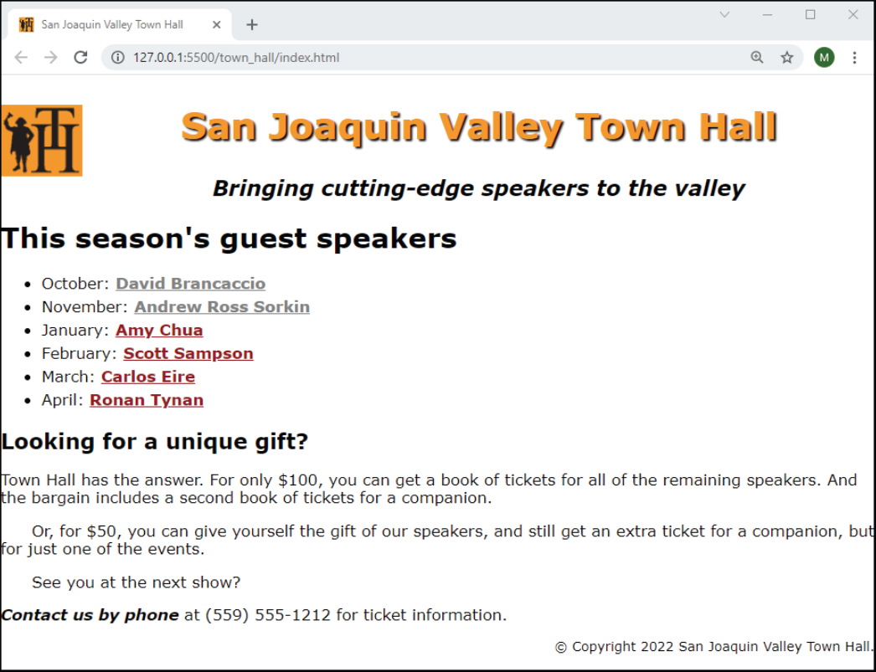
A web page that uses the styles of this chapter

Slide 55
The HTML file for the web page (part 1)
<!DOCTYPE HTML>
<html lang="en">
<head>
<title>San Joaquin Valley Town Hall</title>
<meta charset="utf-8">
<link rel="shortcut icon" href="images/favicon.ico">
<link rel="stylesheet" href="styles/main.css">
</head>
<body>
<header>
<img src="images/logo.gif" alt="Town Hall Logo" width="80">
<h2>San Joaquin Valley Town Hall</h2>
<h3>Bringing cutting-edge speakers to the valley</h3>
</header>

Slide 56
The HTML file for the web page (part 2)
<main>
<h1>This season's guest speakers</h1>
<nav>
<ul>
<li>October: <a class="date_passed"
href="speakers/brancaccio.html"> David Brancaccio</a></li>
<li>November: <a class="date_passed"
href="speakers/sorkin.html">Andrew Ross Sorkin</a></li>
<li>January: <a href="speakers/chua.html">
Amy Chua</a></li>
<li>February: <a href="speakers/sampson.html">
Scott Sampson</a></li>
<li>March: <a href="speakers/eire.html">
Carlos Eire</a></li>
<li>April: <a href="speakers/tynan.html">
Ronan Tynan</a></li>
</ul>
</nav>

Slide 57
The HTML file for the web page (part 3)
<h2>Looking for a unique gift?</h2>
<p>Town Hall has the answer. For only $100, you can get a book of tickets for all of the remaining speakers. And the bargain includes a second book of tickets for a companion.</p>
<p class="indent">Or, for $50, you can give yourself the gift of our speakers, and still get an extra ticket for a companion, but for just one of the events.</p>
<p class="indent">See you at the next show?</p>
<p><em>Contact us by phone</em> at (559) 555-1212 for ticket
information.</p>
</main>
<footer>
<p>&copy; Copyright 2022 San Joaquin Valley Town Hall.</p>
</footer>
</body>
</html>

Slide 58
The CSS file for the web page (part 1)
body {
font-family: Verdana, Arial, Helvetica, sans-serif;
font-size: 100%;
}
a { font-weight: bold; }
a:link { color: #931420; }
a:visited { color: #f2972e;}
a:hover, a:focus { color: blue; }
ul { line-height: 1.5; }
li, p { font-size: 95%; }
em { font-weight: bold; }
header img { float: left; }
header h2 {
font-size: 220%;
color: #f2972e;
text-align: center;
text-shadow: 2px 2px 2px black;
}

Slide 59
The CSS file for the web page (part 2)
header h3 {
font-size: 130%;
font-style: italic;
text-align: center;
}
main { clear: left; }
main h1 { font-size: 170%; }
main h2 { font-size: 130%; }
main p.indent { text-indent: 2em; }
main a.date_passed { color: gray; }
footer p {
font-size: 80%;
text-align: right;
}

Slide 60
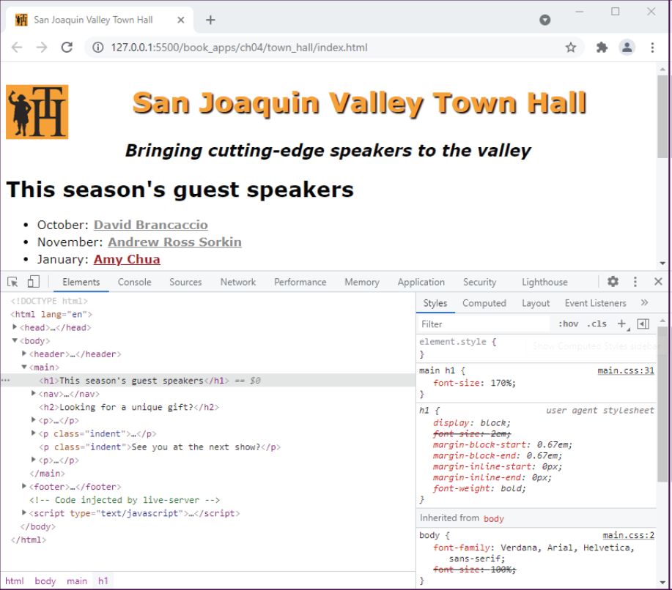
Cascading styles in Chrome’s Developer Tools

Slide 61
How to use Chrome’s Developer Tools
To display the panel for the tools, press the F12 key.
To inspect the styles that have been applied to an element, click on the element in the Elements pane at the left side of the developer tools panel.
The styles that have been applied to the selected element are displayed in the Styles pane at the right side of the developer tools panel.

Slide 62
How to create and use a custom property
The syntax for creating a custom property
selector {
--custom-property: value;
}
The syntax for using a custom property
property: var(--custom-property);

Slide 63
Code that uses a custom property that’s declared in the root pseudoclass
Code that declares the custom property
:root { --color-1: #f2972e; }
Code that uses the custom property
h1 {
color: var(--color-1);
}
nav ul li a {
background-color: var(--color-1);
}
h2 {
text-shadow: 2px 2px 4px var(--color-1);
color: blue;
}

Slide 64
Code that uses a custom property that’s declared in a section
Code that declares the custom property
section {
--color-2: #f2972e;
}
Code that uses the custom property
section h1 { color: var(--color-2); }
section nav ul li a {
background-color: var(--color-2);
}

